Slide 1

For an application of Bitcoin ,Integrate information from various sources to develop a comprehensive understanding of the current memory organization in the high-performance computing cluster. How do the current memory constraints impact the cluster's ability to handle largescale simulations effectively?
BY
d. cHANDU (192211232)
G. Navadeep reddy (192211753)

Slide 2
OBJECTIVES
Understand how Bitcoin works, including its memory organization, data storage requirements, and the role of high-performance computing clusters in Bitcoin mining and transaction processing.
Explore the concepts and technologies behind high-performance computing clusters, including memory architectures, storage systems, and parallel processing techniques.
Discuss potential future developments in memory technologies and their implications for high-performance computing clusters. Consider advancements such as non-volatile memory, heterogeneous memory systems, and novel memory architectures.

Slide 3
ABSTRECT
The research will involve a detailed analysis of the cluster's memory organization, covering aspects such as memory types, hierarchy, allocation strategies, and optimizations. By evaluating the existing memory constraints, including bandwidth, latency, and capacity limitations, the study will assess how these factors influence the cluster's performance in conducting large-scale simulations. Furthermore, the project will propose recommendations for optimizing memory usage within the cluster. These recommendations may involve memory management strategies, hardware upgrades, software optimizations, or architectural modifications. The study will also consider future trends in memory technologies and their potential impact on high-performance computing clusters. Through this comprehensive investigation, the project aims to provide insights into enhancing the cluster's ability to handle demanding simulations efficiently, contributing to advancements in both Bitcoin mining and broader high-performance computing applications.

Slide 4
INTRODUCTION
In the realm of high-performance computing (HPC) clusters, the efficient allocation and utilization of memory resources are paramount for handling large-scale simulations effectively. With the rising prominence of applications like Bitcoin, which rely heavily on intricate computational processes and vast data handling, understanding the nuances of memory organization within an HPC cluster becomes critical. Bitcoin, as a decentralized cryptocurrency, operates on a complex network of nodes that collaboratively manage transactions and secure the blockchain through cryptographic algorithms. These operations necessitate substantial computational power and efficient memory access to validate transactions, mine new blocks, and maintain the integrity of the distributed ledger. The impact of these memory constraints on the cluster's performance becomes particularly pronounced when dealing with large-scale simulations, where the computational workload intensifies, and the demand for memory resources surges. In such scenarios, inefficiencies in memory organization can lead to increased processing times, reduced throughput, and potential scalability limitations, ultimately hindering the cluster's overall effectiveness in handling complex computations and simulations.

Slide 5
METHODOLOGY
Based on the findings from the literature review, data analysis, and evaluation, provide actionable recommendations for optimizing memory utilization and enhancing the performance of Bitcoin, Integrate modelling simulations on HPC clusters. These recommendations should address specific memory constraints and provide practical guidance for cluster administrators and researchers.

Slide 6

HIGH PERFORMANCE COMPUTING:
The practice of aggregating computing resources to gain performance greater than that of a single workstation, server, or computer

Slide 7
Assess Current Memory Organization
Evaluate the current memory architecture of the high-performance computing cluster, including types of memory (e.g., RAM, cache, storage), their capacities, and their interconnectivity.
Analyze the memory hierarchy (registers, L1/L2/L3 cache, RAM, disk storage) to understand data movement and latency implications.
Investigate the memory management system, including allocation policies, virtual memory settings, and memory access patterns.

Slide 8
Evaluate Memory Constraints
Identify the limitations and bottlenecks imposed by the current memory constraints on the cluster's performance, especially concerning largescale simulations.
Measure memory utilization during various workload scenarios to determine peak usage, contention points, and potential areas for optimization.
Benchmark memory-intensive applications or simulations to quantify the impact of memory limitations on performance metrics such as throughput, latency, and scalability.

Slide 9
Analyze Performance Impact
Conduct performance profiling and analysis to understand how memory constraints affect different aspects of largescale simulations, such as computational speed, data transfer rates, and overall efficiency.
Compare performance metrics under varying memory workloads, including scenarios with limited memory, high memory contention, and optimized memory allocation strategies.
Investigate the relationship between memory constraints and system stability, including potential issues like memory leaks, thrashing, and resource exhaustion during heavy workloads.

Slide 10
Develop Optimization Strategies
Propose and implement optimization techniques to mitigate the impact of memory constraints on largescale simulations, such as data compression, prefetching, caching strategies, and parallelization.
Evaluate the effectiveness of optimization strategies through experimental testing and performance analysis, measuring improvements in simulation speed, resource utilization, and scalability.
Document best practices and guidelines for memory management in largescale computing clusters, including recommendations for hardware upgrades, software configurations, and workload optimizations.

Slide 11
Coding
import pandas as pdimport numpy as npimport randomimport datetimedef simulate_memory_usage_data(node_count=10, days=7): """ Simulates memory usage data for a cluster. :param node_count: Number of nodes in the cluster. :param days: Number of days to simulate data for. :return: DataFrame with simulated memory data. """ timestamps = pd.date_range(end=datetime.datetime.now(), periods=24*days, freq='H') data = { 'timestamp': np.tile(timestamps, node_count), 'node_id': np.repeat(range(node_count), len(timestamps)), 'memory_used_gb': [random.uniform(50, 200) for _ in range(node_count * len(timestamps))], 'memory_total_gb': 256 # Assuming each node has 256 GB of total memory for simplicity. } return pd.DataFrame(data)# Simulate memory usage datamemory_data = simulate_memory_usage_data()print(memory_data.head())

Slide 12
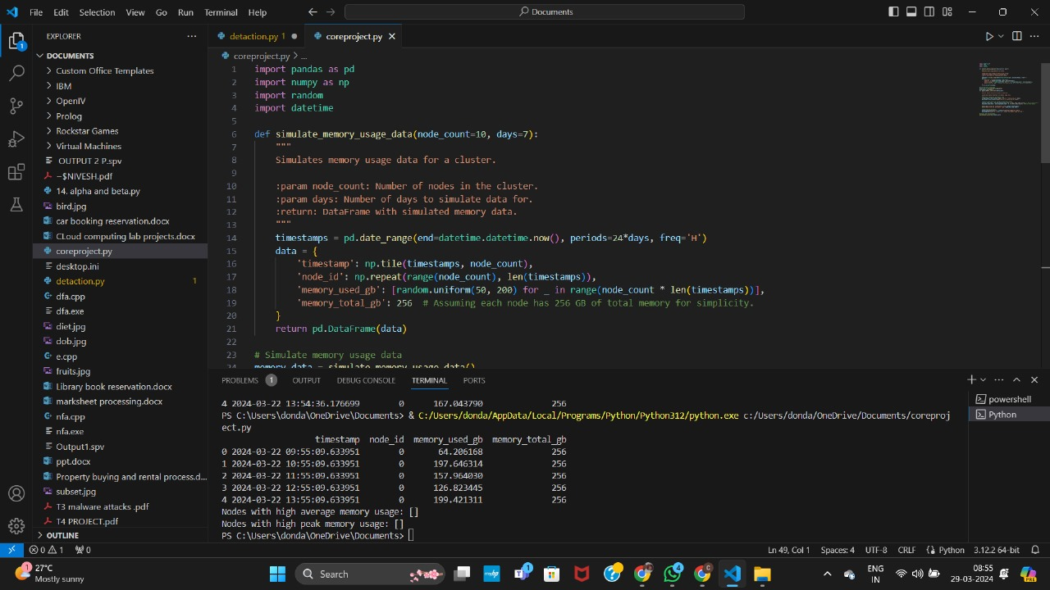
Implementation:

Slide 13
Conclusion
In conclusion, the analysis of the current memory organization in high-performance computing clusters plays a crucial role in their ability to handle large-scale simulations effectively, particularly in the context of applications like Bitcoin mining. By integrating information from various sources, we can develop a comprehensive understanding of the challenges and opportunities presented by these memory constraints.

Slide 14
Result
In understanding and addressing the current memory constraints in high-performance computing clusters are essential for optimizing their ability to handle large-scale simulations effectively, including applications like Bitcoin mining. By implementing strategic optimizations and exploring emerging memory technologies, we can pave the way for more efficient and powerful computing systems in the future.

Slide 15
REFERENCE
Sterling, Thomas, Maciej Brodowicz, and Matthew Anderson. High performance computing: modern systems and practices. Morgan Kaufmann, 2017.
Yue, Xuanwu, Xinhuan Shu, Xinyu Zhu, Xinnan Du, Zheqing Yu, Dimitrios Papadopoulos, and Siyuan Liu. "Bitextract: Interactive visualization for extracting bitcoin exchange intelligence." IEEE transactions on visualization and computer graphics 25, no. 1 (2018): 162-171.
Garcia, David, and Frank Schweitzer. "Social signals and algorithmic trading of Bitcoin." Royal Society open science 2, no. 9 (2015): 150288.
Asch, Mark, Terry Moore, R. Badia, Micah Beck, P. Beckman, T. Bidot, François Bodin et al. "Big data and extreme-scale computing: Pathways to convergence-toward a shaping strategy for a future software and data ecosystem for scientific inquiry." The International Journal of High Performance Computing Applications 32, no. 4 (2018): 435-479.

